Slide 1

Write An Objective Function (2)
Professor Bo Liu
James Watt School of Engineering

Slide 2
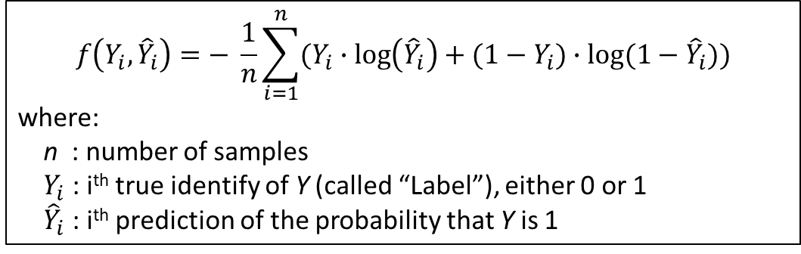
Binary cross entropy
The binary cross entropy function can be used to calculate the error between a predicted probability and the true probability.
  The “binary” refers to the fact that the true identity of the data item is one of two discrete types.
  When the data item can belong to more than two discrete types, then we must use Categorical Cross Entropy.
Frequently used as a loss function when predicting probabilities that an item belongs to one of two categories:
Formula:
$$f\left(Y_{i},{\hat{Y}}_{i}\right)=− \frac{1}{n}\sum_{i=1}^{n}{(Y_{i}∙\log\left({\hat{Y}}_{i}\right)+(1−Y_{i})∙\log{(1−{\hat{Y}}_{i}))}}$$
where:
n : number of samples
$Y_{i}$ : i^{th} true identify of Y (called “Label”), either 0 or 1
${\hat{Y}}_{i}$ : i^{th} prediction of the probability that Y is 1

Slide 3
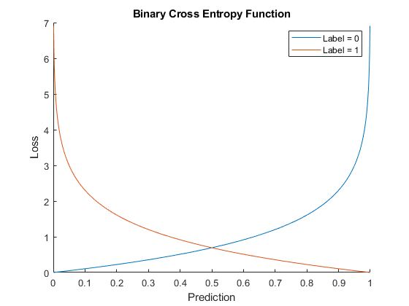
Binary cross entropy visualization
We can plot the value of the binary cross entropy function against the prediction for the case when the true label is 0 and 1:
Note, asymptotic at P = 0 and P = 1

Slide 4
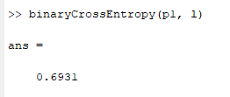

Binary cross entropy in MATLAB
Binary cross entropy function as MATLAB code:
Example: classifying animals in images. An image can contain a horse (label = 0), or a dog (label = 1).
  Two models are shown a picture of a dog and predict probabilities of the image containing a dog of 0.5 and 0.95. Quantify the accuracy of each prediction using the binary cross entropy function
function loss = binaryCrossEntropy(preds, labels)
loss = -mean(labels.*log(preds) + (1-labels).*log(1-preds));
end
l = 1; p1 = 0.5; p2 = 0.95;
See live script
Loss is lower

Slide 5




Thanks!
#UofGWorldChangers
@UofGlasgow

